Slide 1
Intro to Databases and API
Deepsea Dev, Xiaobin Lin
Microsoft Student Partners

Slide 2
Creating the Database and API
API
ASP.NET Core in Visual Studio
Database
Azure SQL Server
Source Control
GitHub

Slide 3
Introduction to database
Why Databases?
Basics
Fields and records
Interacting with the database
SQL

Slide 4
Why databases?
Large volumes of information are generated everyday through devices such as
Smartphones
Laptops
Cars
Databases help organize this information so that it easy to
Query
Sort
And manipulate this data.

Slide 5
Database Basics
Databases are usually presented in the form of a number of tables
Students Table:
Student ID (PK) | Student Name | DOB
1 | John Smith | 3/4/1997
2 | Michael Adams | 2/5/1998
3 | Sarah Johnson | 6/12/1997
Tuple or record
Attribute

Slide 6
Interacting with DB's
SQL (Structured Query Language)
SQL is a way for you to interact with these tables and will allow you to query sort and manipulate the data.
Example of an SQL Query
SELECT * FROM STUDENTS WHERE Student ID = '8268654';
Student ID | Student Name | DOB
8268654 | Sarah Johnson | 6/12/1997
Notes:
In this example the query would return all column relating to 'Sarah Johnson' as she has the student id '8268654'
Note that the * means select everything meaing all columns.
It is also important to note sql queries end with a semi-colon ';'

Slide 7
CREATE TABLE
The statement to create a new table in the database
Example
CREATE TABLE [Students]( id INT NOT NULL IDENTITY(1,1) PRIMARY KEY, name VARCHAR(50), dob DATE );
Students
id | name | dob

Slide 8
Additional Resources for database
https://beginner-sql-tutorial.com/sql-commands.htm
https://www.w3schools.com/SQl/
Old but gold
https://youtu.be/e7Pr1VgPK4w

Slide 9
Introduction to RESTful API
What is an API?
RESTful API?
HTTP request
Create/Read/Update/Delete
Interacting with the database
SQL

Slide 10
RESTful API
API
Application Programming Interface
REST Architectural
Uniform interface, Client – Server, Stateless, Cacheable, Layered System, Code on demand
Representational State Transfer
RESTful API provides a simple way for one service to communicate with another.

Slide 11
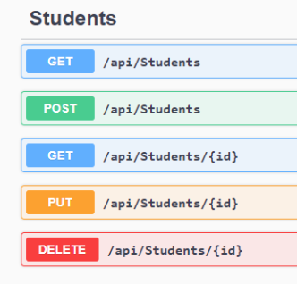
HTTP methods for CRUD operations
POST (Create new information)
GET (Read information)
PUT (Update information)
DELETE (Delete information)

Slide 12
HTTP Status code
2XX: Success
4XX: Client Side error
5XX: Server side error
…

Slide 13
Additional Resources for API
https://restfulapi.net/rest-architectural-constraints/
https://swagger.io/docs/specification/api-host-and-base-path/
https://www.restapitutorial.com/

Slide 14
Thanks!

